Slide 1
Two-Way ANOVA
Cohen – chapter 14 textbook example

Slide 2
3 x 4 two-way ANOVA, complex motor tasks
DV (dependent variable)
score on a video game that simulates driving a large truck at night
IV (categorical independent variables)
Sleep deprivation (subjects spend four days in a sleep lab)
(1) Control: allowed to follow their own sleep schedule
(2) Jet Lag: keep usual amount, but not allow any during 11pm-7am
(3) Interrupted: usual amount, but no more that 2 hours at a time, separated by 1+ hours awake
(4) Total Deprivation: total lack of any sleep
Stimulant
(1) placebo: sugar pill, but told it is caffeine
(2) caffeine: caffeine pill, told it is caffeine
(3) reward: mild electric shocks for mistakes & money for good performance
Subjects
n = 5 per [sleep x stimulant] combination… 5 x (4 x 3) = 5 x 12 = 60 ← n_{T}

Slide 3
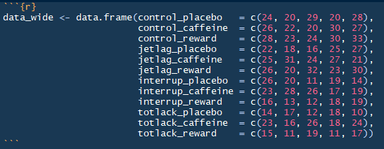
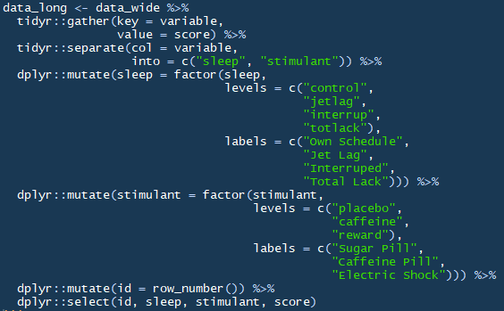
data
 | Placebo | Caffeine | Reward
Control | 24 | 26 | 28
 | 20 | 22 | 23
 | 29 | 20 | 24
 | 20 | 30 | 30
 | 28 | 27 | 33
Jet Lag | 22 | 25 | 26
 | 18 | 31 | 20
 | 16 | 24 | 32
 | 25 | 27 | 23
 | 27 | 21 | 30
Interrupted | 16 | 23 | 16
 | 20 | 28 | 13
 | 11 | 26 | 12
 | 19 | 17 | 18
 | 14 | 19 | 19
Total Lack | 14 | 23 | 15
 | 17 | 16 | 11
 | 12 | 26 | 19
 | 18 | 18 | 11
 | 10 | 24 | 17

Slide 4
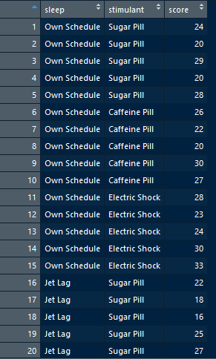
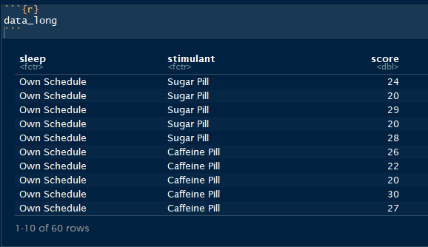
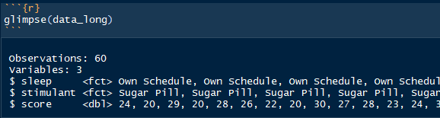
Data – with R

Slide 5

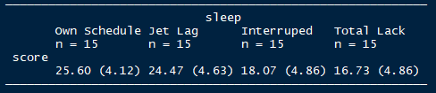

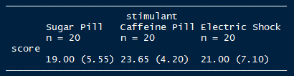

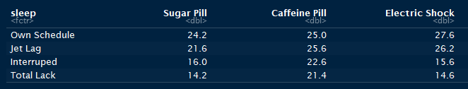
Marginal Mean’s
 | Placebo | Caffeine | Reward
Control | 24 | 26 | 28 | M = 25.6 N = 15
 | 20 | 22 | 23
 | 29 | 20 | 24
 | 20 | 30 | 30
 | 28 | 27 | 33
Jet Lag | 22 | 25 | 26 | M = 24.47 N = 15
 | 18 | 31 | 20
 | 16 | 24 | 32
 | 25 | 27 | 23
 | 27 | 21 | 30
Interrupted | 16 | 23 | 16 | M = 18.07 N = 15
 | 20 | 28 | 13
 | 11 | 26 | 12
 | 19 | 17 | 18
 | 14 | 19 | 19
Total Lack | 14 | 23 | 15 | M = 16.73 N = 15
 | 17 | 16 | 11
 | 12 | 26 | 19
 | 18 | 18 | 11
 | 10 | 24 | 17
 | M = 19.0 N = 20 | M = 23.65 N = 20 | M = 21.0 N = 20 | M = 21.217 N = 60
 | Placebo | Caffeine | Reward
Control | 24 | 26 | 28
 | 20 | 22 | 23
 | 29 | 20 | 24
 | 20 | 30 | 30
 | 28 | 27 | 33
Jet Lag | 22 | 25 | 26
 | 18 | 31 | 20
 | 16 | 24 | 32
 | 25 | 27 | 23
 | 27 | 21 | 30
Interrupted | 16 | 23 | 16
 | 20 | 28 | 13
 | 11 | 26 | 12
 | 19 | 17 | 18
 | 14 | 19 | 19
Total Lack | 14 | 23 | 15
 | 17 | 16 | 11
 | 12 | 26 | 19
 | 18 | 18 | 11
 | 10 | 24 | 17
 | Placebo | Caffeine | Reward
Control | 24.2 | 25.0 | 27.6 | 25.60
Jet Lag | 21.6 | 25.6 | 26.2 | 24.47
Interrupted | 16.0 | 22.6 | 15.6 | 18.07
Total Lack | 14.2 | 21.4 | 14.6 | 16.73
 | 19.0 | 23.65 | 21.00 | 21.217

Slide 6

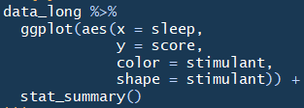
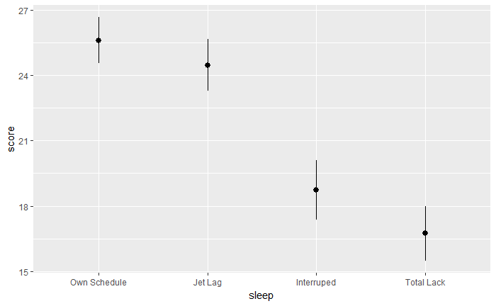
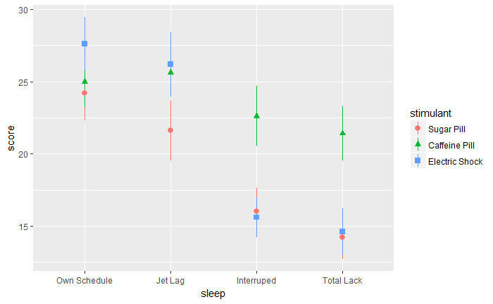
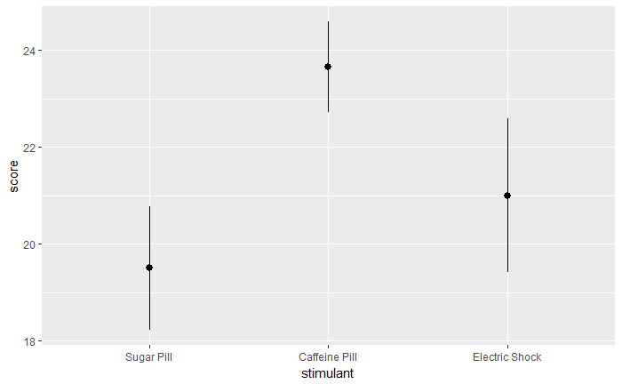

Plot of mean’s
 | Placebo | Caffeine | Reward
Norm | 24.2 | 25.0 | 27.6 | 25.6
Lag | 21.6 | 25.6 | 26.2 | 24.47
Int | 16.0 | 22.6 | 15.6 | 18.07
None | 14.2 | 21.4 | 14.6 | 16.73
 | 19.0 | 23.65 | 21.0 | 21.217
Main Effect of Sleep
Interaction between Sleep & Stimulant
Main Effect of Stimulant

Slide 7
Degrees of Freedom
c = number of columns
r = number of rows
n = subjects per cell
Total
60 – 1 = 59
Denominator of F ratios
Total
Between cells
Rows
Columns
Interaction
Within cells
= rnc – 1
= rc - 1
= r - 1
= c - 1
= (r – 1)(c – 1)
= rnc - rc
Between Cells
Within Cells
12 – 1 = 11
60 - 12 = 48
Rows
Columns
4 – 1 = 3
3 – 1 = 2
Interaction
Numerators of F ratios
3 x 2 = 6

Slide 8

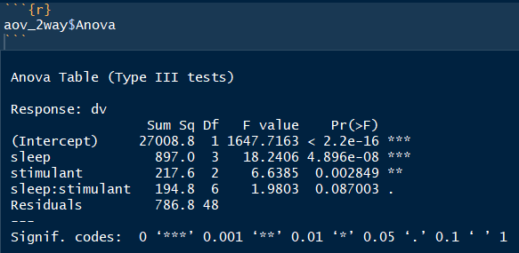
2-way ANOVA
IF the interaction is significant…
main effects should not be interpreted in isolation
 | SS | Df | MS | F | p
Between-Cells | 1309.38 | 11
SLEEP Row Groups | 896.98 | 3 | 298.99 | 18.241 | <.001
STIM Column Groups | 217.63 | 2 | 108.82 | 6.639 | .003
INTER (Row x Col) | 197.77 | 6 | 32.46 | 1.980 | .087
Within-Cells (Residual) | 786.80 | 48 | 16.39
Total | 2096.18 | 59

Slide 9



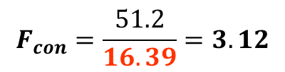




Interaction contrasts
$$2x2: {df}_{con}=\left(r−1\right)\left(c−1\right)=1$$
If the interaction is significant…
pick TWO PAIRS to compare (extreme)
Does CAFFEINE have the same effect in NO SLEEP as NORMAL SLEEP?
$c_{i}=$ 1, -1, -1, 1
Caffeine’s Effect in Normal
Caffeine’s Effect in None
$$\sum{c_{i}^{2}}=4$$
$$L= \left( {\overline{X}}_{11} − {\overline{X}}_{12} \right) − \left( {\overline{X}}_{21} − {\overline{X}}_{22} \right)$$
$$L={ \overline{ X}}_{11} − {\overline{X}}_{12} − {\overline{X}}_{21} + {\overline{X}}_{22}$$
 | Placebo | Caffeine | Reward
Norm | 24.2 | 25.0 | 27.6 | 25.6
Lag | 21.6 | 25.6 | 26.2 | 24.47
Int | 16.0 | 22.6 | 15.6 | 18.07
None | 14.2 | 21.4 | 14.6 | 16.73
 | 19.0 | 23.65 | 21.0 | 21.217
 | Placebo | Caffeine
Norm | 24.2 | 25.0
 | Placebo | Caffeine | Reward
Norm | 24.2 | 25.0 | 27.6 | 25.6
Lag | 21.6 | 25.6 | 26.2 | 24.47
Int | 16.0 | 22.6 | 15.6 | 18.07
None | 14.2 | 21.4 | 14.6 | 16.73
 | 19.0 | 23.65 | 21.0 | 21.217
$$L={ 1∙\overline{ X}}_{11} + −1∙{\overline{X}}_{12} + −1∙{\overline{X}}_{21} +1∙{\overline{X}}_{22}$$
$$L={ 1∙}_{} + −1∙ + −1∙ +1∙$$
$$L=24.2 −25.0 −14.2+21.4=6.4$$
24.2
25.0
$${SS}_{con}= \frac{n∙L^{2}}{\sum{c_{i}^{2}}}$$
$$F_{con}= \frac{{SS}_{con}}{{MS}_{W}}$$
14.2
21.4
None | 14.2 | 21.4
$${SS}_{con}=\frac{5∙{6.4}^{2}}{1+1+1+1}=\frac{5∙40.96}{4}=\frac{204.8}{4}=51.2$$
$$F_{Scheffe}={df}_{int}∙F\left({df}_{int}, {df}_{W}\right)$$
$$F_{con}=\frac{51.2}{16.39}=3.12$$
$F_{Scheffe}=6∙F\left(6, 48\right)=6∙F_{.05}\left(6, 40\right)=6∙2.34=14.04$

Slide 10
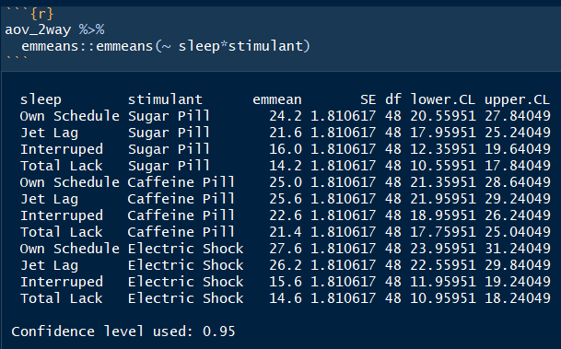
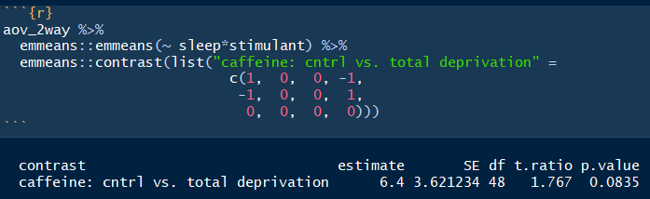
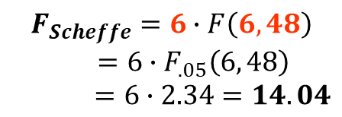
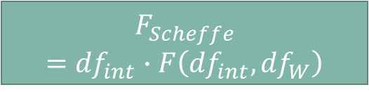


Interaction contrasts - with R
Caffeine’s Effect in Normal
Caffeine’s Effect in None
#1) See the order of the Means
$$L= \left( {\overline{X}}_{11} − {\overline{X}}_{12} \right) − \left( {\overline{X}}_{21} − {\overline{X}}_{22} \right)$$
1
-1
 | Placebo | Caffeine
Norm | 24.2 | 25.0
#2) Choose the Weights
1
-1
0
0
0
0
0
0
0
0
None | 14.2 | 21.4
-1
1
-1
1
#3) Run the Contrast
#4) Compute Scheffe’s Test by Hand
$F_{con}=$ $t_{con}$²
$$F_{con}={1.767}^{2}=3.12$$
$$F_{Scheffe}=6∙F\left(6, 48\right)$$
$$=6∙F_{.05}\left(6, 48\right)$$
$=6∙2.34=14.04$
$$F_{Scheffe}$$
$$={df}_{int}∙F\left({df}_{int}, {df}_{W}\right)$$

Slide 11

Interaction contrasts
Does CAFFEINE have the same effect in NO SLEEP as NORMAL SLEEP?
 | Placebo | Caffeine | Reward
Norm | 24.2 | 25.0 | 27.6 | 25.6
Lag | 21.6 | 25.6 | 26.2 | 24.47
Int | 16.0 | 22.6 | 15.6 | 18.07
None | 14.2 | 21.4 | 14.6 | 16.73
 | 19.0 | 23.65 | 21.0 | 21.217
Are the lines PARALLEL?
$$F_{contrast}=3.12$$
Vs
$F_{Scheffe}=14.04$
0.8
7.2
Just compare the 2 pairs of points
(ignore the rest)
This provides no evidence
that CAFFEINE has a different effect
in NORMAL SLEEP vs TOTAL DEPRIVATION.

Slide 12
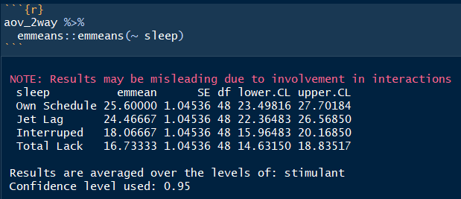
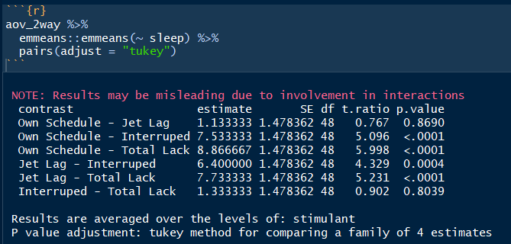
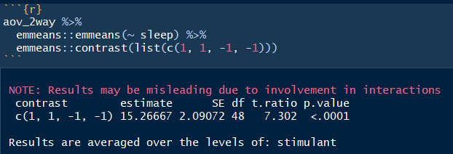
Main effect - Sleep
 | Placebo | Caffeine | Reward
Norm | 24.2 | 25.0 | 27.6 | 25.6
Lag | 21.6 | 25.6 | 26.2 | 24.47
Int | 16.0 | 22.6 | 15.6 | 18.07
None | 14.2 | 21.4 | 14.6 | 16.73
 | 19.0 | 23.65 | 21.0 | 21.217
See the order of the Means
Main Effect of Sleep
All Pairwise Post Hoc Tests
Two-Way ANOVA
Linear Contrast Test
This DOES provides evidence
that INTERUPTED SLEEP
Results in LOWER scores,
on average.

Slide 13
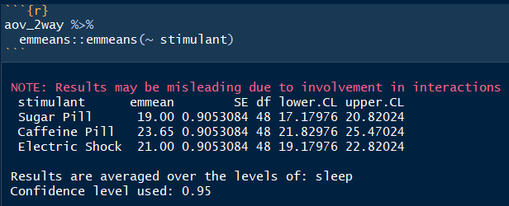
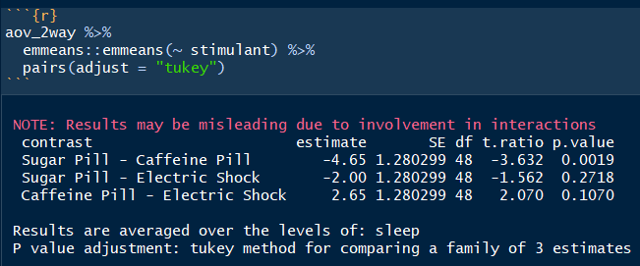
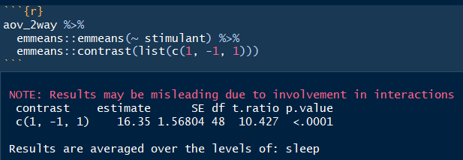
Main effect - Stimulant
 | Placebo | Caffeine | Reward
Norm | 24.2 | 25.0 | 27.6 | 25.6
Lag | 21.6 | 25.6 | 26.2 | 24.47
Int | 16.0 | 22.6 | 15.6 | 18.07
None | 14.2 | 21.4 | 14.6 | 16.73
 | 19.0 | 23.65 | 21.0 | 21.217
See the order of the Means
Main Effect of Stimulant
All Pairwise Post Hoc Tests
Two-Way ANOVA
Linear Contrast Test
This DOES provides evidence
that CAFFEINE
Results in HIGHER scores,
on average.

Slide 14
Two-way ANOVA TABLES
Two-Way ANOVA
Source | SS | df | MS | F | p
Row
Column
R x C
Within |  |  |  | X | X
Total |  |  | X | X | X

Slide 15
Interactions: 2 forms
Ordinal
Direction or order of effects is similar for different subgroups
Disordinal
Direction or order of effects is reversed for different subgroups

Slide 16
interactions
Significance of interaction always evaluated 1st
If significant, interpret interaction, not main effects
If non-significant, interpret main effects
Once we know effects of 1 factor are tempered by or contingent on levels of another factor (as in an interaction), interpretation of either factor (main effect) alone is problematic
Best interpreted through visualization
Cell means plot
Interactions exist if lines cross or will cross (non-parallel)
Design graph to best illustrate
Outcome on y-axis
Select factor for x-axis
Other factor(s) represented by separate lines
Selection guides interpretation, can dictate whether plot is ordinal/disordinal

